Slide 1
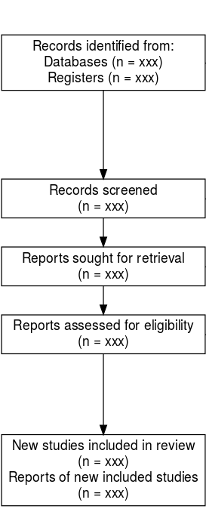
medrxivr allows for systematic searching of medRxiv and bioRxiv databases
medrxivr provides tools to automatically download full text PDFs of preprints based on a DOI (similar to EndNote’s “Find Full Text” feature)

Slide 2
Chapter 3:
Tool for searching health-related preprints
Chapter 4:
Comprehensive systematic review
Chapters 1 & 2: Introduction and Background
Chapter 5:
Analysis of statins in the CPRD
Chapter 7:
Triangulation
Chapters 8: Discussion, Future work, Conclusion
Chapter 6:
IPD analysis of lipids levels in several cohorts

